Slide 1
Introduction to Programming
Intro to Python Week 4

Slide 2
Control structures
Sequential control vs selection control vs iterative control
A control statement is a statement that determines the control flow of a set of statements.
A control structure is a set of statements and the control statements controlling their execution.
Three fundamental forms of control in programming are
Sequential
Selection
Iteration.

Slide 3
Decision Making

Slide 4
Making Decision
The Python if statement is used to implement the decision.
if boolean_expression: python_code
The python_code is a sequence of one or more statements indented under the if heading.
The body is executed if boolean_expression is evaluated to True.
The body is skipped if boolean_expression is evaluated to False

Slide 5
Boolean Expressions (Conditions)
The Boolean data type contains two Boolean values, denoted as True and False in Python.
A Boolean expression is an expression that evaluates to a Boolean value.
Need a relational operator to evaluate a boolean expression.
The relational operators on the next slide can be applied to any set of values that has an ordering.
Number comparison
Lexicographical ordering for string comparison

Slide 6
Relational Operators
Python | Mathematics | Meaning
< | < | Less than
<= | ≤ | Less than or equal to
== | = | Equal to
>= | ≥ | Greater than or equal to
> | > | Greater than
!= | ≠ | Not equal to

Slide 7
Logical Operators
The in operator is used to determine if a specific value is in a given list, returning True if found, and False otherwise.
The not operator reverses/negates a boolean result
The not in operator returns the opposite result of in .
The in operator

Slide 8
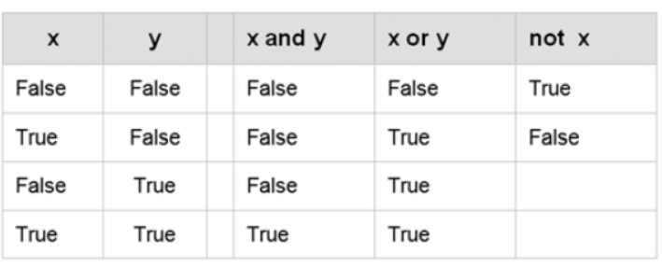
Truth Tables
Source: Charles Dierbach. 2013. Introduction to Computer Science Using Python. Wiley.

Slide 9
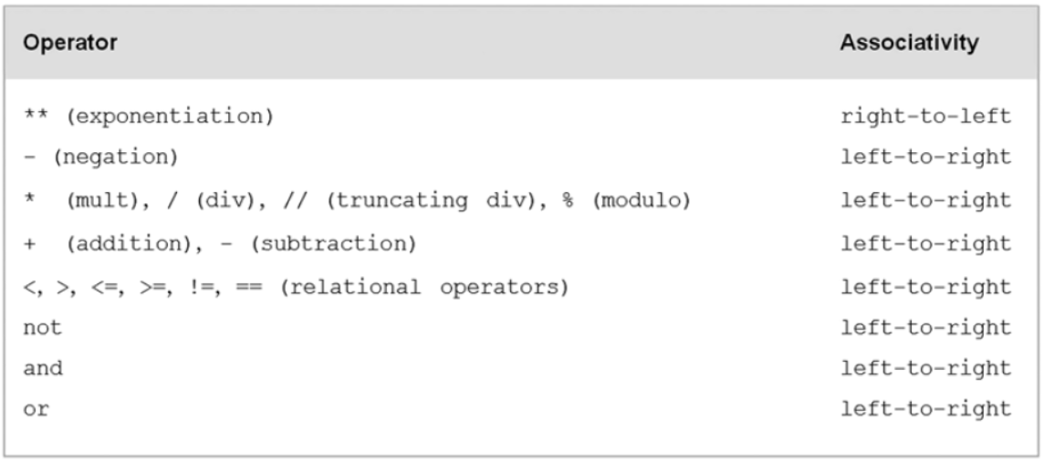
Operator Precedence
Source: Charles Dierbach. 2013. Introduction to Computer Science Using Python. Wiley.

Slide 10
Two-Way Decisions
In Python, a two-way decision can be implemented by attaching an else clause onto an if clause.
This is called an if-else statement: if <boolean_expression>: <python_code> else: <python_code>

Slide 11
Multi-Way Decisions
Use nested if-else statement to implement multi-way decisions.
if <condition1>: <case1 statements>
else: if <condition2>: <case2 statements>
else:
if <condition3>: <case3 statements> else: <default statements>

Slide 12
Multi-Way Decisions using elif
In Python, else-if can be combined into elif:
if <condition1>: <case1 statements> elif <condition2>: <case2 statements> elif <condition3>: <case3 statements> else: <default statements>
The else is optional. If there is no else, it is possible that no indented block would be executed.

Slide 13
Loops

Slide 14
For Loops: A Quick Review
The for statement allows us to iterate through a sequence of values.
for <var> in <sequence>: <body>
The loop index variable var takes on each successive value in the sequence, and the statements in the body of the loop are executed once for each value.
For example,
for num in range(0, 10):
print(num)

Slide 15
Indefinite Loops
The for loop is a definite loop, meaning that the number of iterations is determined when the loop starts.
We can’t use a definite loop unless we know the number of iterations ahead of time.
The indefinite or conditional loop keeps iterating until certain conditions are met.

Slide 16
Indefinite Loops
while <boolean_expression>: <python_code>
Semantically, the body of the loop executes repeatedly as long as the condition remains true. When the condition is false, the loop terminates.

Slide 17
Nested Loops
Creating a loop inside of a loop
How to design Nested Loop?
Break the problem into two parts.
The first is to process line by line (outer loop).
The second is to process the items on each line (inner loop).
Note that the two parts are not inter-dependent.

Slide 18
Post-Test Loop
Say we want to write a program that is supposed to get a nonnegative number from the user.
If the user types an incorrect input, the program asks for another value.
This process continues until a valid value has been entered.
This process is input validation.

Slide 19
Using a break
Some programmers prefer to simulate a post-test loop by using the Python break statement.
Executing break causes Python to immediately exit the enclosing loop.
For example,
while True: number = eval(input("Enter a positive number: ")) if number >= 0:
break # Exit loop if number is valid
Avoid using break often within loops, because the logic of a loop is hard to follow when there are multiple exits.

Slide 20
Skipping Iterations
Use the continue keyword to skip the current iteration
Example
num = 1
while num < 10:
If num > 5 and num < 8:
num +=1
continue
print(num)
num += 1

Slide 21
Comprehensions
List, Tuples & Dictionary0

Slide 22
List Comprehension
[expression for element in list]
A compact syntax that can replace loops that alter lists
Applies the expression to each element in the list
You can have 0 or more for or if statements

Slide 23
List comprehensions
An if statement can be added to the end to allow selecting only certain elements of the original list
[expression for element in list if condition]
vec = [2, 3, 4, 5, 6]
result = [x for x in vec if x % 2 == 0]
print(result) # [2, 4, 6]
result2 = [x ** 2 for x in vec if x % 2 == 0 and x < 5]
print(result2) # [4, 16]

Slide 24
List Comprehension
Compact, concise way to create lists
Replaces
new_list = []
for i in old_list:
if filter(i):
new_list.append(expressions(i))

Slide 25
List Comprehension
With
new_list = [expression(i) for i in old_list if filter(i)]
Examples
[chr(x) for x in range(65, 90 + 1, 5)]
[chr(x) for x in range(65, 90 + 1) if not x % 5]
[ord(x) for x in "Hello! World? 123" if x.isalpha()]

Slide 26
More List Comprehension Examples
More than one element can be generated from each element in the original list
vec = [2, 4, 6]
result = [[x, x ** 2] for x in vec]
print(result) # [[2, 4], [4, 16], [6, 36]]
result2 = [(x, x ** 2) for x in vec]
print(result2) # [(2, 4), (4, 16), (6, 36)]

Slide 27
Nested List Comprehension
You can write a list comprehension to go over a list of lists
matrix = [[0,1,2,3], [4,5,6,7], [8,9,10,11]]
flattened = [i for row in matrix for i in row]
# [0, 1, 2, 3, 4, 5, 6, 7, 8, 9, 10, 11]

Slide 28
Set Comprehension
Set comprehensions work just like list comprehensions except that they are surrounded by {}
vec = [2, 4, 6]
result = {3 * x for x in vec}
print(result) # {6, 12, 18}
vec2 = [2, 4, 6, 2, 2, 4, 3]
result2 = {3 * x for x in vec2}
print(result2) # {6, 12, 18, 9}

Slide 29
Dictionary Comprehension
Dictionary comprehensions work similarly to list and set comprehensions except that they are surrounded by {} and generate key, value pairs
original = {'two' : 2, 'four' : 4, 'six' : 6}
{value: key for key, value in original.items()}
What’s the output?
{2: 'two', 4: 'four', 6: 'six'}

